Slide 1

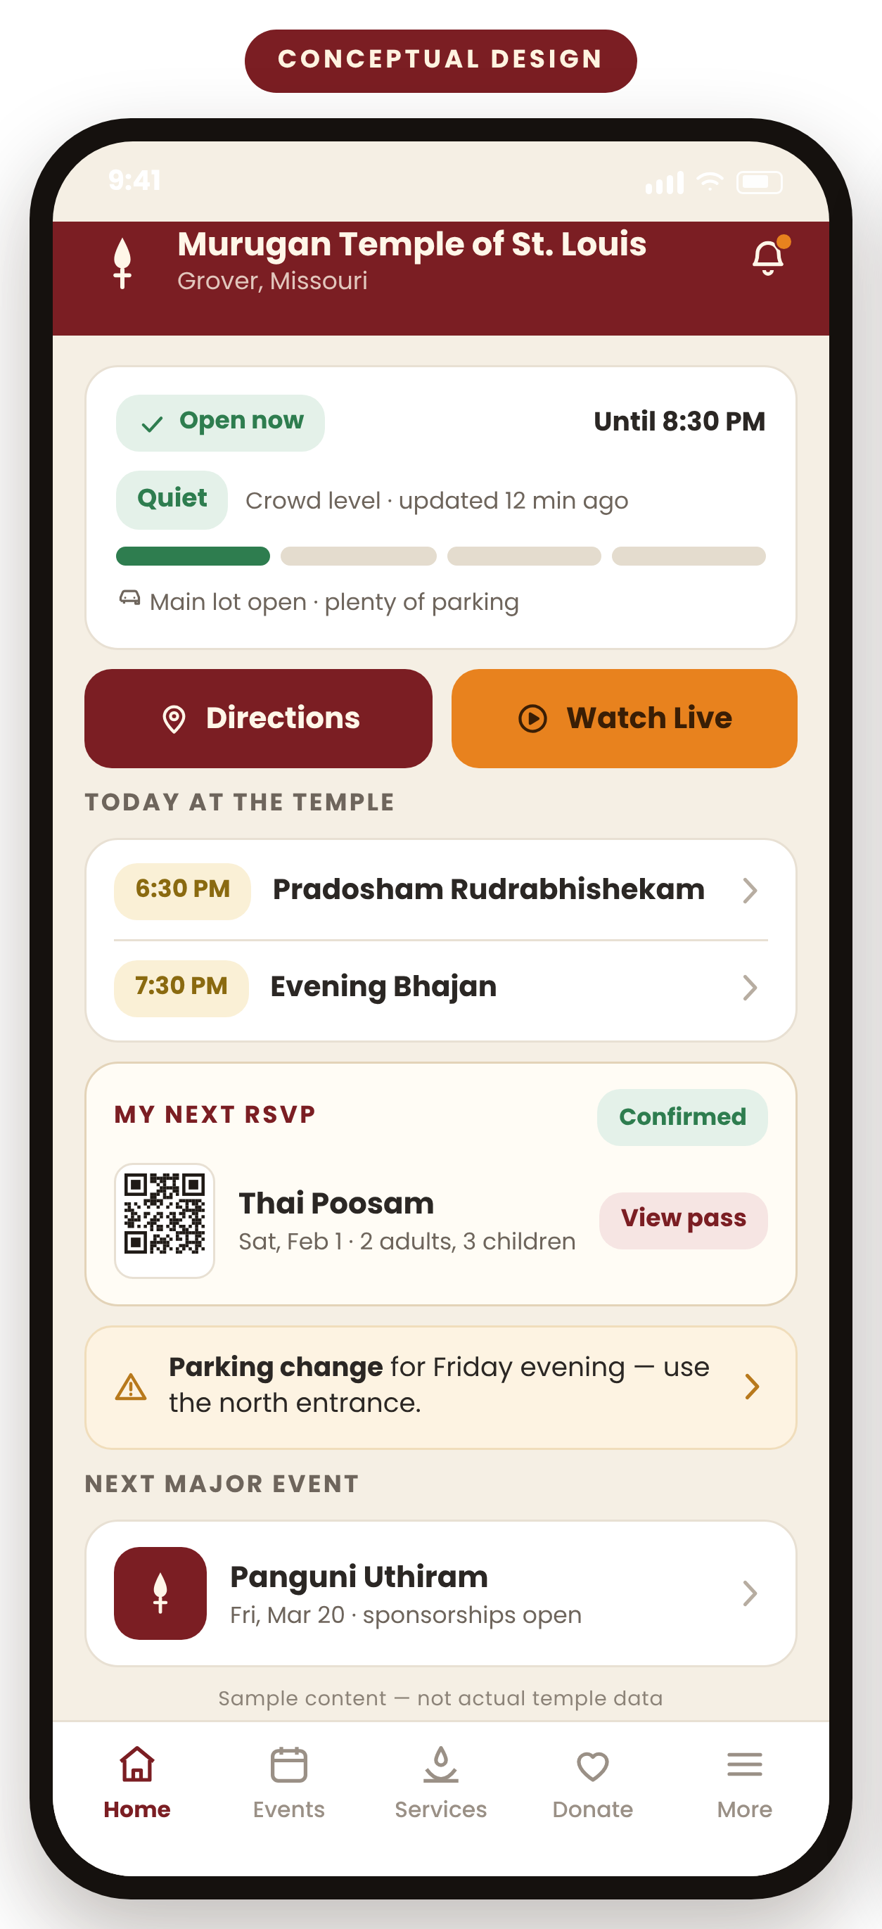
MURUGAN TEMPLE OF ST. LOUIS · PROPOSAL FOR TEMPLE LEADERSHIP
A Simpler Temple Experience
One app that brings the temple's schedule, services, sponsorships, giving and timely updates into a single place — easier for devotees to use, and easier for our volunteers to run.
iOS and Android
Senior-friendly by design
Discovery before build
Discussion document. Nothing shown here has been approved, purchased or built. Every screen is a conceptual design.
1
Notes:
Opening (about 60 seconds).
Say: "Thank you for the time. What I'd like to show you today is a picture of what a temple app could feel like — and then ask for permission to go and check whether it is right."
Make the one-sentence case: the temple already has a good website. What it does not have is something that reaches a devotee's pocket — that reminds them, shows them their own booking, and tells them what is happening right now.
Set expectations twice, clearly: every screen in this deck is a conceptual design, drawn to make the conversation concrete. No app exists. Nothing has been bought. Nobody has been hired.
Likely question: "How much will this cost?" — Answer: that is exactly what we are not able to say responsibly yet, and slide 12 explains what we are asking for instead.

Slide 2




THE OPPORTUNITY
A website waits to be visited. A phone reaches out.
Personal, not general
The website already does a great deal
A website shows everything to everyone. An app can show me my next RSVP, my sponsorships and my receipts — and nothing else.
Mission and history
2026 temple calendar
Pooja and abhishekam bookings
Donations and square-foot giving
It arrives at the right moment
Volunteer sign-up form
MTS Live and past programmes
A page only helps a devotee who thinks to open it. A notification reaches the family who would otherwise have missed the change.
+
One tap instead of five
Directions, add to calendar, watch live, show my pass — single actions rather than finding the right page on a small screen.
What a phone adds on top
Reminders that arrive
My RSVPs and receipts
Current, not just published
One-tap directions and pass
Status before you travel
Open or closed, today's programme, crowd and parking, a weather closure — accurate at the moment somebody asks.
A voice for closures and changes
Status you can trust offline
A complement to the website — not a replacement for it.
Website capabilities listed above are confirmed from the temple's own site: Services / Pooja Events, Calendar and MTS Digital Calendar, Donate (square foot, monthly, stocks), Volunteer Sign Up and MTS Live. Reviewed September 2026 — murugantempleofstlouis.org
2
Notes:
Message: mobile is a different reach, not a prettier website.
Say: "Everything on the right-hand side of this slide already exists and works. I am not here to replace any of it. The question is what happens between visits to the website."
Walk the four points on the left quickly — personal, timely, fast, current. Land on the second one: the website cannot reach out. Only a notification can.
Likely question: "Couldn't we just send emails or WhatsApp messages?" — Answer honestly: yes, for some of this, and we should test that in discovery. Where a phone is genuinely different is the pass in your pocket, the one-tap directions, and status that is correct at the moment you look.
Assumption to validate: that devotees actually want notifications from the temple, and which kinds.

Slide 3
TODAY'S FRICTION
Where devotees and volunteers lose time today
FOR DEVOTEES
FOR THE TEMPLE TEAM
CONFIRMED ON SITE
HYPOTHESIS — TO TEST IN DISCOVERY
You have to remember to check
The same questions, over and over
The live page asks devotees to bookmark it and come back to look for a stream. Nothing tells a family that one has started.
Volunteers and office staff likely spend real time answering timing, parking and service questions one at a time.
CONFIRMED ON SITE
HYPOTHESIS — TO TEST IN DISCOVERY
Attending, sponsoring and giving share one basket
No fast way to tell everybody
Pooja events, abhishekam sponsorships and donations all move through the same store and cart, so quite different intentions look alike.
A time change or a weather closure has no single channel that reliably reaches the families who planned to come.
CONFIRMED ON SITE
HYPOTHESIS — TO TEST IN DISCOVERY
Visit basics are spread across pages
Volunteers coordinated away from the event
Calendar, digital calendar and cultural events sit on separate pages, and opening hours are not published on the site at all.
Sign-up is a separate form, not attached to the event a volunteer is helping with. The workload this creates needs measuring.
None of this is a fault of the website — it is doing its job. The hypotheses are precisely what discovery interviews are for.
Confirmed items observed on murugantempleofstlouis.org (MTS Live, Services / store and cart, Calendar, MTS Digital Calendar, Volunteer Sign Up), September 2026. Opening hours were not found published on the site — Requires Temple Confirmation.
3
Notes:
Message: name the friction honestly, and be equally honest about what we do not yet know.
Say: "Three of these I can show you on the website right now. Three are guesses — sensible ones, but guesses — and I would rather label them that way than dress them up as findings."
Point at the green labels versus the amber labels explicitly. That distinction is the credibility of this whole deck.
Do not attack the website. If anyone hears criticism, correct it immediately: the site is well maintained and does a lot; this is about the gap between visits.
Likely question: "Are people actually complaining?" — Answer: we do not have that evidence, which is why we are asking to go and interview people rather than asking to build.
Assumption to validate: whether opening hours exist and are published somewhere we did not find.

Slide 4
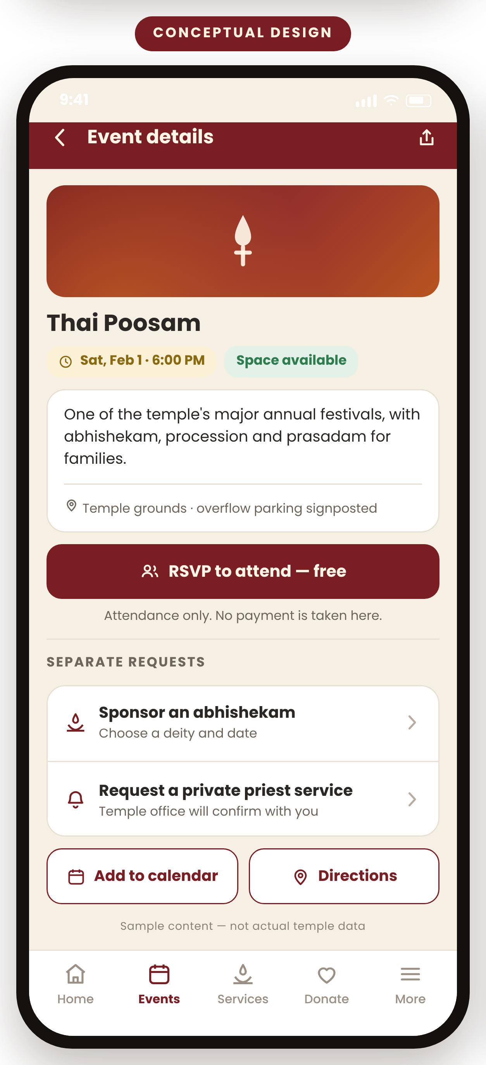
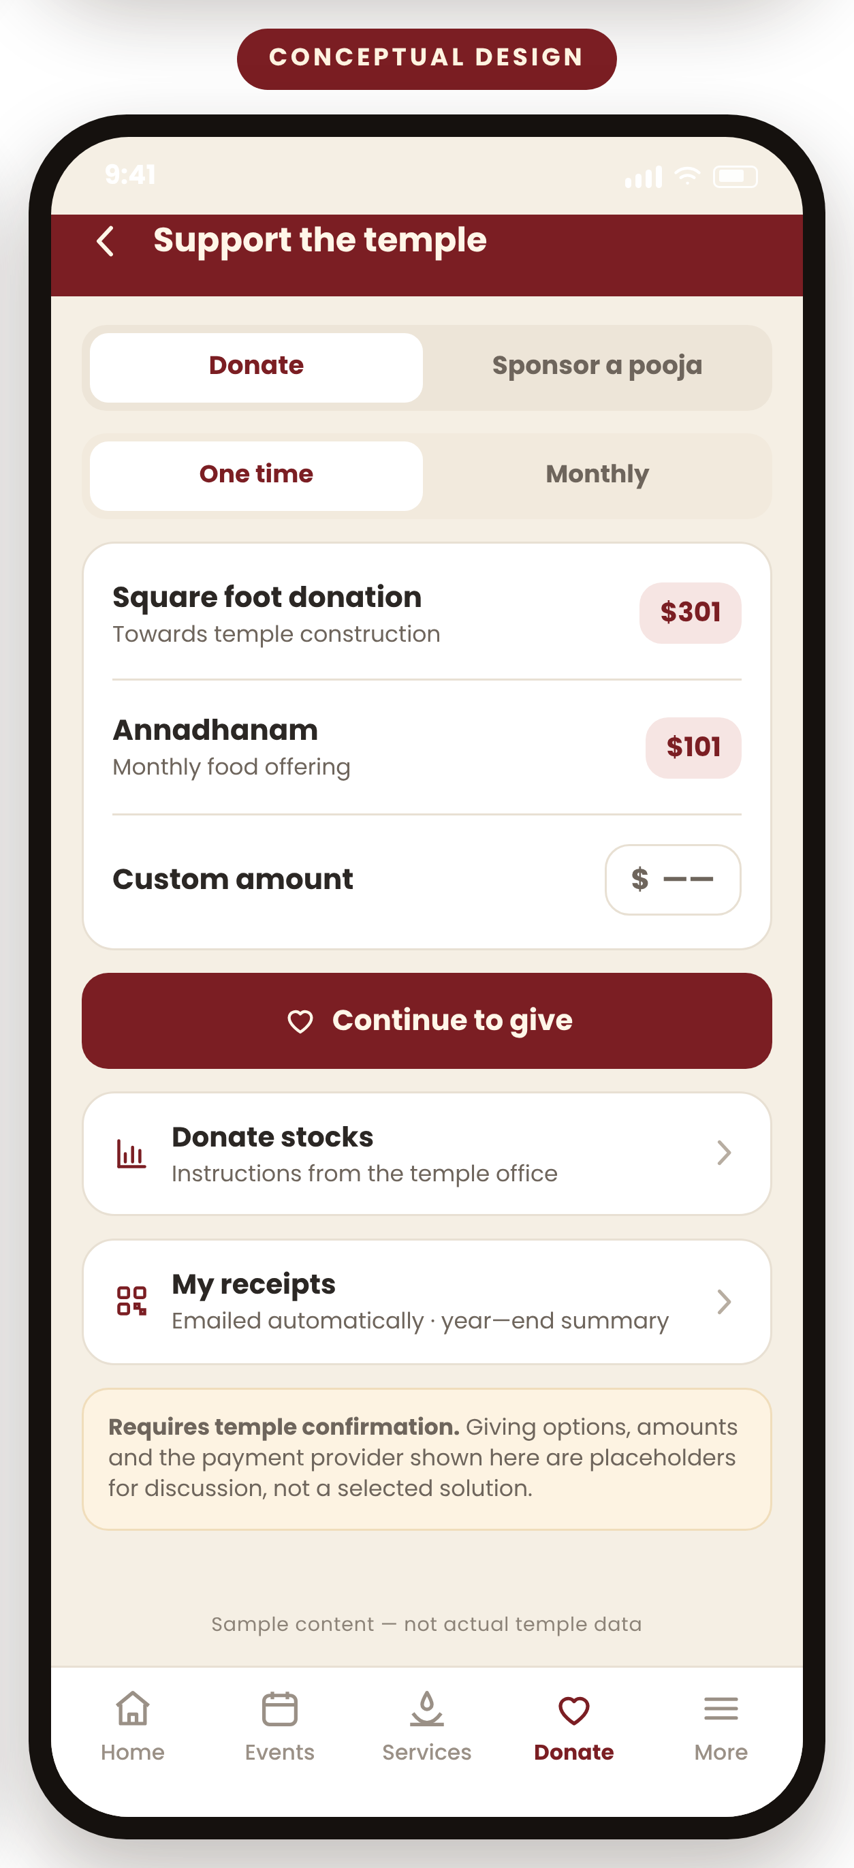





MEET THE APP
Five simple places to go — and nothing else to learn
Home
Today at a glance: open or closed, hours, crowd, what is on.
Events
Find a pooja or festival, RSVP for the family, get reminded.
Services
Sponsor an abhishekam or request a private priest service.
Donate
One-time, monthly, square foot, stock — and your receipts.
More
Volunteer, live streams, visit information, settings.
The same five tabs sit at the bottom of every screen, so nobody has to learn where things live.
Home
Event details
Support the temple
Conceptual designs. Screen content is illustrative sample data, not temple data. Service names shown reflect categories published on the temple's website.
4
Notes:
Message: the whole app is five tabs. That is the entire mental model.
Say: "If a devotee remembers nothing else, they only need to remember that the temple's app has five buttons at the bottom, and they never move."
Walk the five names slowly — Home, Events, Services, Donate, More. Point out that Services and Donate are deliberately separate, because sponsoring a pooja and giving to construction are different acts.
Invite them to look at the three screens rather than read them. The point is the feel: calm, uncluttered, large type.
Likely question: "Why not more features?" — Answer: because five is what a senior devotee can hold in their head, and because everything we add before we have talked to people is a guess.

Slide 5
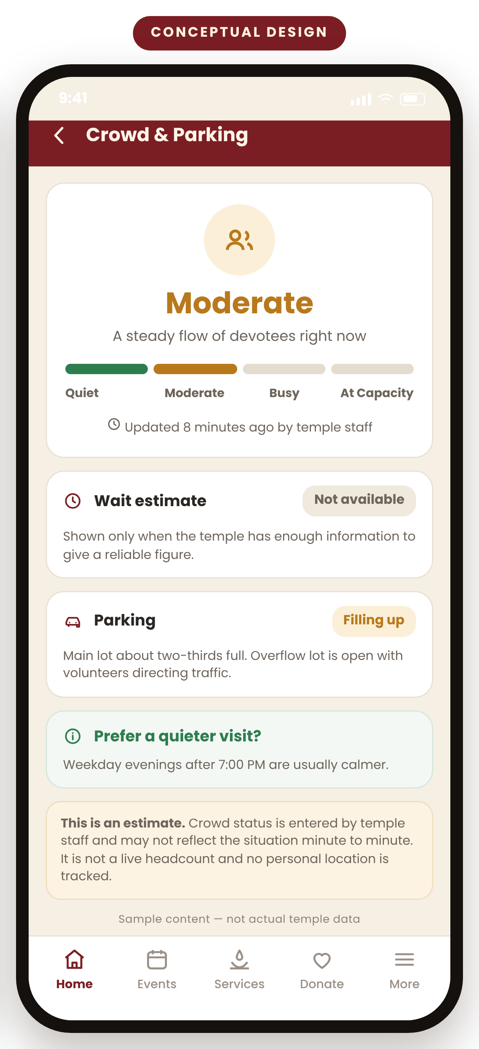





KNOW BEFORE YOU GO
Answer the questions asked before leaving the house
On the home screen
An honest crowd meter
Open or closed right now, and today's hours
Today's poojas and the next major festival
Watch Live when a programme is on
Directions, parking and the accessible entrance
Quiet
Moderate
Busy
At Capacity
Every state carries a word and an icon — never colour alone.
Plan your visit
How the status would be produced
Dress and etiquette guidance for first-time visitors
Frequently asked questions
Weather and emergency closure notices
Contact the temple office or a priest
Saved offline so it works with a weak signal
First version
A volunteer taps one of four buttons.
Later
Combine RSVP numbers and QR check-ins.
Future, only if validated
Consider an anonymous entrance counter.
Never continuous location tracking. The status is an estimate, and the screen says so.
Conceptual design. Opening hours, capacity limits, parking arrangements and accessible-entrance details were not found published on the temple website — all Require Temple Confirmation before any of this is built.
5
Notes:
Message: the app answers the questions a family asks in the car, and it answers them honestly.
Say: "The single most common question before any visit is some version of 'what will it be like when we get there?' Today there is no good way to answer it."
Spend most of the time on the crowd meter, because it is the feature most likely to worry the board. Make three promises out loud: it is an estimate and labelled as one; it is entered by a person, not inferred from anyone's phone; and there is never any tracking of where devotees are.
Explain the three-step rollout in plain words: to begin with, a volunteer presses one of four buttons.
Likely question: "Who is going to keep it updated?" — Good question, and it is on the pilot list: if staff cannot keep it current, we should not ship it.
Likely question: "What if the estimate is wrong?" — Then it says 'updated 40 minutes ago' and people can judge for themselves. We would rather show staleness than pretend precision.

Slide 6
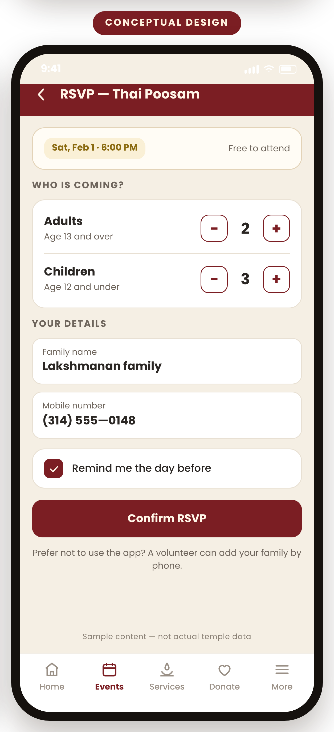
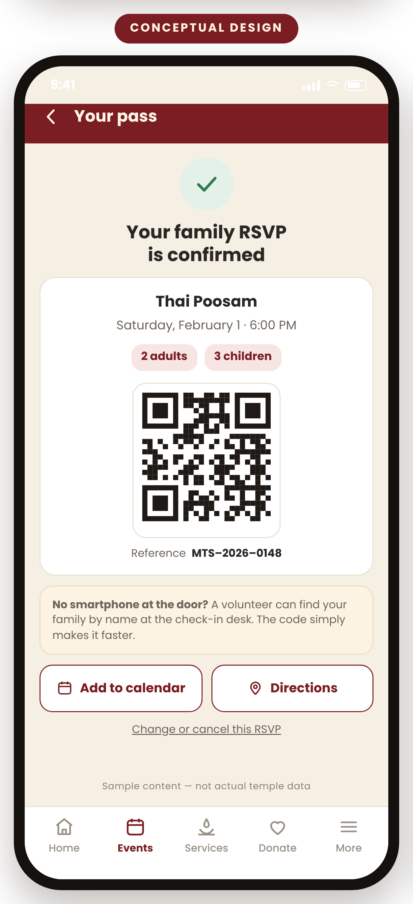
FIND, RSVP, ATTEND
One family journey, from noticing to arriving
1
Find the event in the calendar or on the home screen
2
See details, timing and whether space is available
3
RSVP for the family — adults and children counted separately
4
Get a confirmation, with an optional QR pass
5
Add it to a personal phone calendar in one tap
6
Receive a reminder, or an alert if the time or place changes
7
Check in at the door, change the numbers, or cancel
Three separate doors — never one checkout
RSVP to attend free
Sponsor a pooja a sponsorship
Private priest service a request
Family RSVP
Confirmation and pass
Conceptual design. Event name, date, party size and reference number are illustrative sample data. Capacity rules, whether a waitlist is needed and who may cancel an RSVP all Require Temple Confirmation.
6
Notes:
Message: one clear journey a family can complete in under a minute, and three requests that must never be blurred together.
Walk the seven numbered steps briefly — do not read every word. Stop at step four and hold up the confirmation screen: "this is the thing a family shows at the door."
Then make the separation point deliberately, because it matters to the priests in the room: attending is free and instant; sponsoring an abhishekam is a sponsorship with a receipt; a private priest service is a request that the office confirms. Three doors, never one basket.
Point out the note on the pass screen: a volunteer can still find a family by name. The QR only makes it faster.
Likely question: "What if the same family RSVPs twice, or does not turn up?" — That is exactly the sort of rule discovery has to settle with the people who run the door.

Slide 7
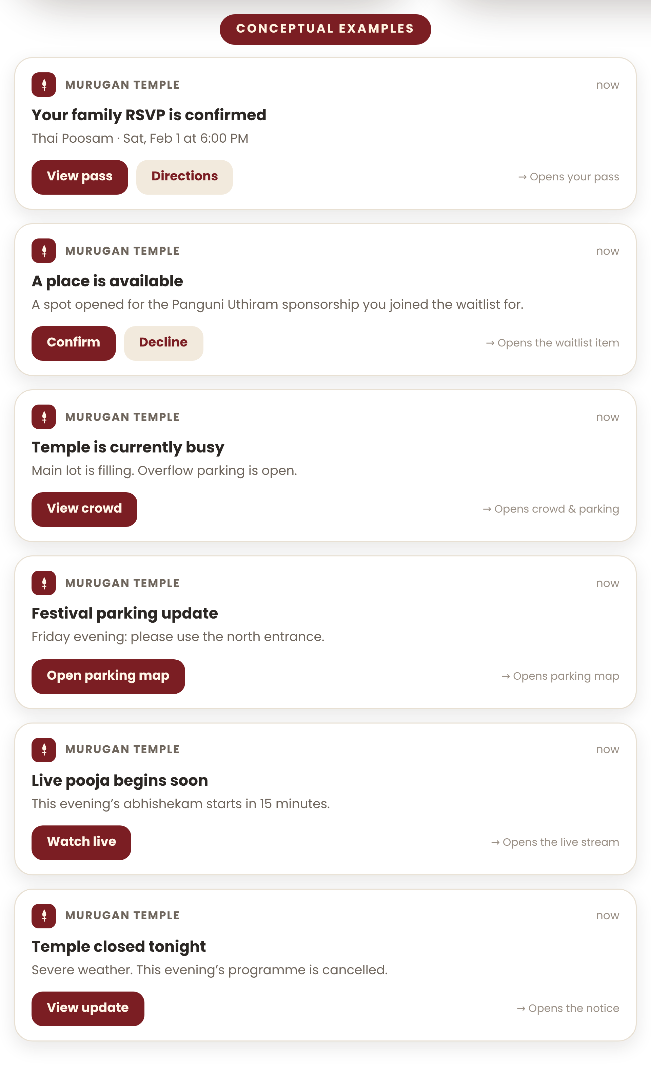
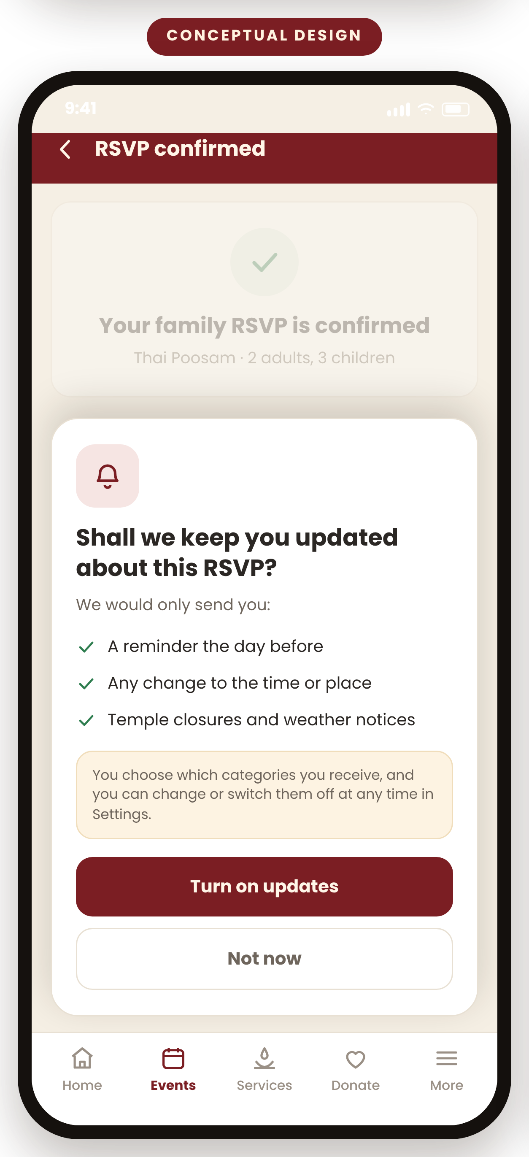
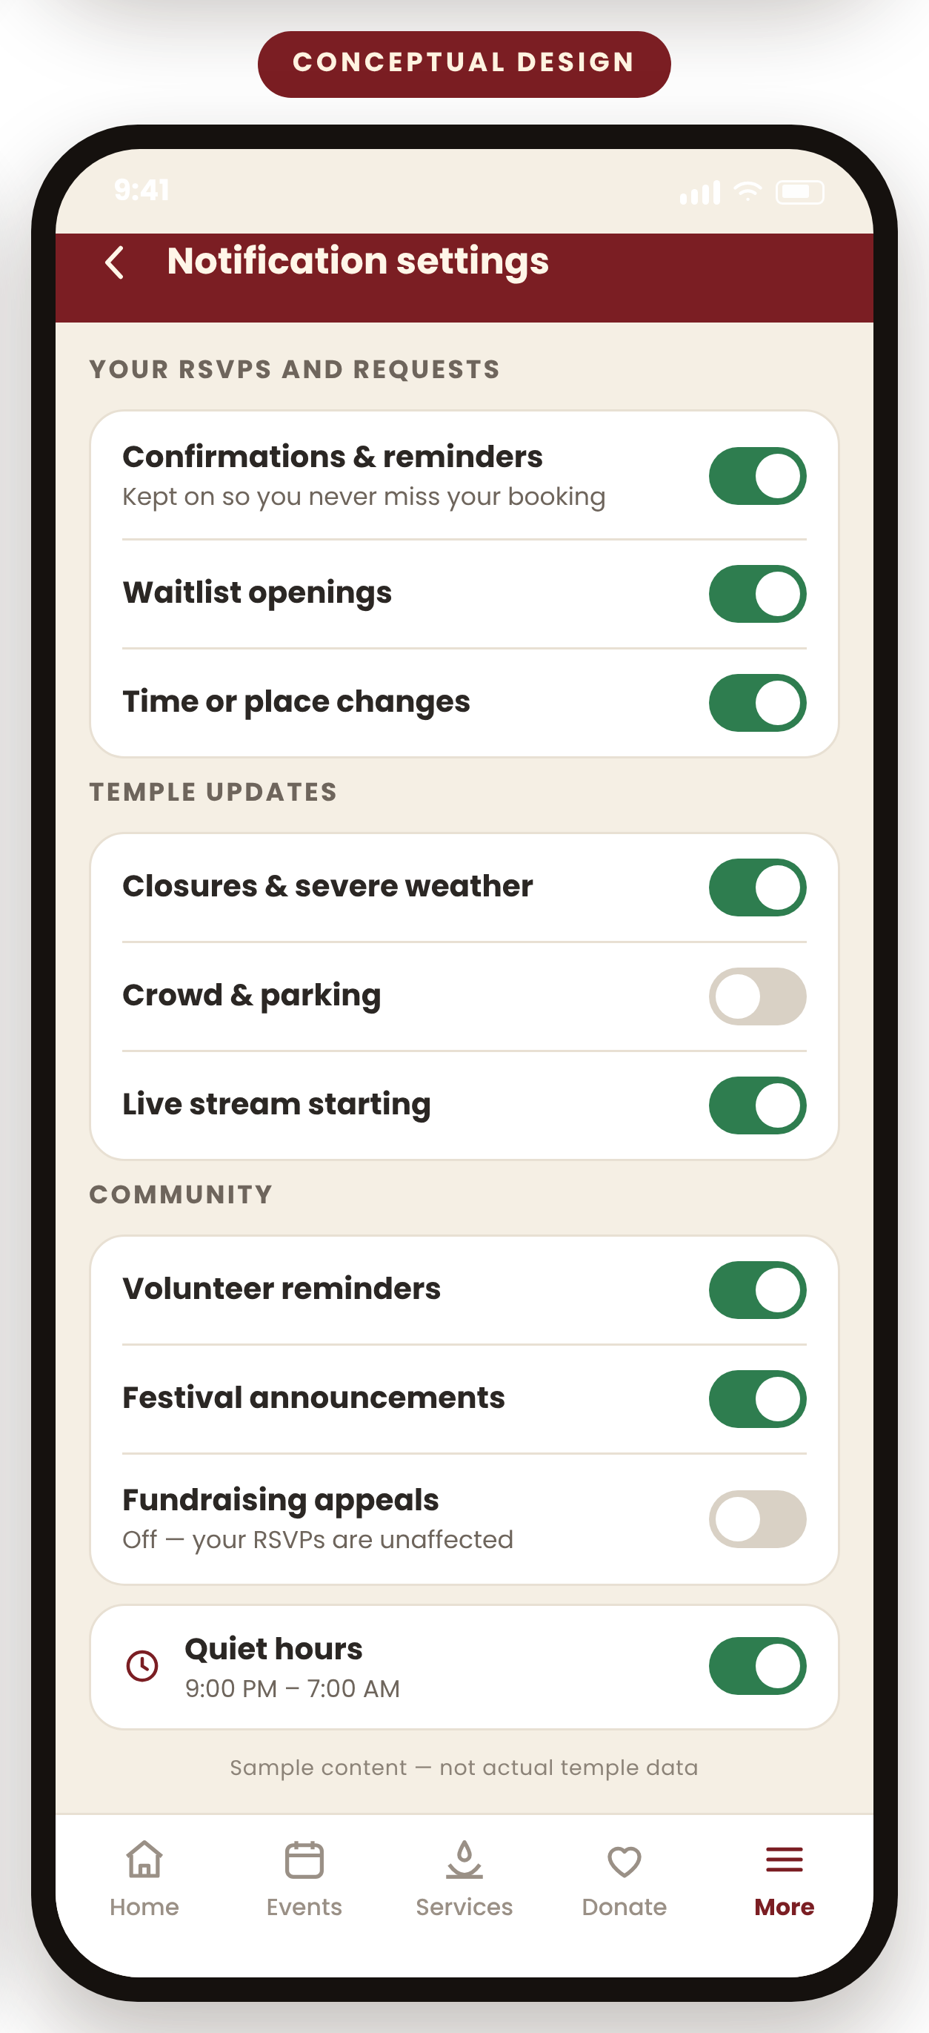

NOTIFICATIONS
Relevant updates, not noise
Asked at the right moment
Permission is requested after a devotee finishes an RSVP — never on first launch.
Categories, not all or nothing
Fundraising appeals can be switched off while RSVP confirmations stay on.
Quiet hours
Nothing arrives late at night unless it is a closure notice.
Every alert opens the right screen
Tapping View Pass opens the pass — not the home screen.
Conceptual examples. All names, dates, times and messages shown are illustrative. Which categories the temple actually wants to send, and who may send them, Requires Temple Confirmation.
7
Notes:
Message: notifications are the strongest reason to have an app at all — and the fastest way to lose people's trust if handled badly.
Read two of the example alerts aloud, ideally the closure one and the waitlist one. Those are the moments where a message genuinely helps a family.
Then move immediately to the controls, because that is what reassures a board. Three commitments: we ask only after somebody has done something that makes an alert relevant; devotees choose categories, so they can mute fundraising and keep their RSVP reminders; and nothing arrives late at night unless the temple is closed.
Make the deep-link point simply: if a message says View Pass, tapping it shows the pass. No hunting.
Likely question: "Will we annoy people?" — Only if we send things nobody asked for. The settings screen on the right is the answer, and opt-in rates are one of the pilot measures.

Slide 8

SERVICES, SPONSORSHIPS AND GIVING
Four different intentions, kept clearly apart
RSVP to attend
Say that your family is coming to a pooja or festival.
Ends with: a confirmation and an optional QR pass. No payment.
Sponsor a pooja or abhishekam
Choose the service, the deity and the date — annual or monthly.
Ends with: a sponsorship confirmation and a receipt.
Request a private priest service
Ask about a naming, ear-piercing, or another family ritual.
Ends with: the temple office contacting you to confirm. It is a request, not a booking.
Donate
One-time, monthly, square foot for construction, or stock.
Ends with: a receipt, and a year-end summary in the app.
Giving and sponsorship categories, and the two amounts shown on the screen, are those published in the temple's own online store (Square Foot Donation, Monthly Donation – Annadhanam, Annual and Monthly Abhishekam sponsorship, Custom Donation, Donate Stocks) — murugantempleofstlouis.org/store, September 2026. No payment provider or integration has been selected — Requires Temple Confirmation.
8
Notes:
Message: four intentions that must never share a checkout.
Say: "Right now, saying you will attend, sponsoring an abhishekam and giving towards construction all pass through the same basket. In an app we can give each one its own door, and each one its own ending."
Emphasise the third lane for the priests: a private service is a request, not an instant booking. The app should never imply the temple has committed a priest before the office says so.
On money, be precise: the two amounts on the screen are the temple's own published figures, and no payment provider has been chosen. That is a discovery decision, and it belongs to the treasurer.
Likely question: "Will we pay card fees twice?" — Unknown, and worth checking. Payment constraints are explicitly on the validation list.

Slide 9
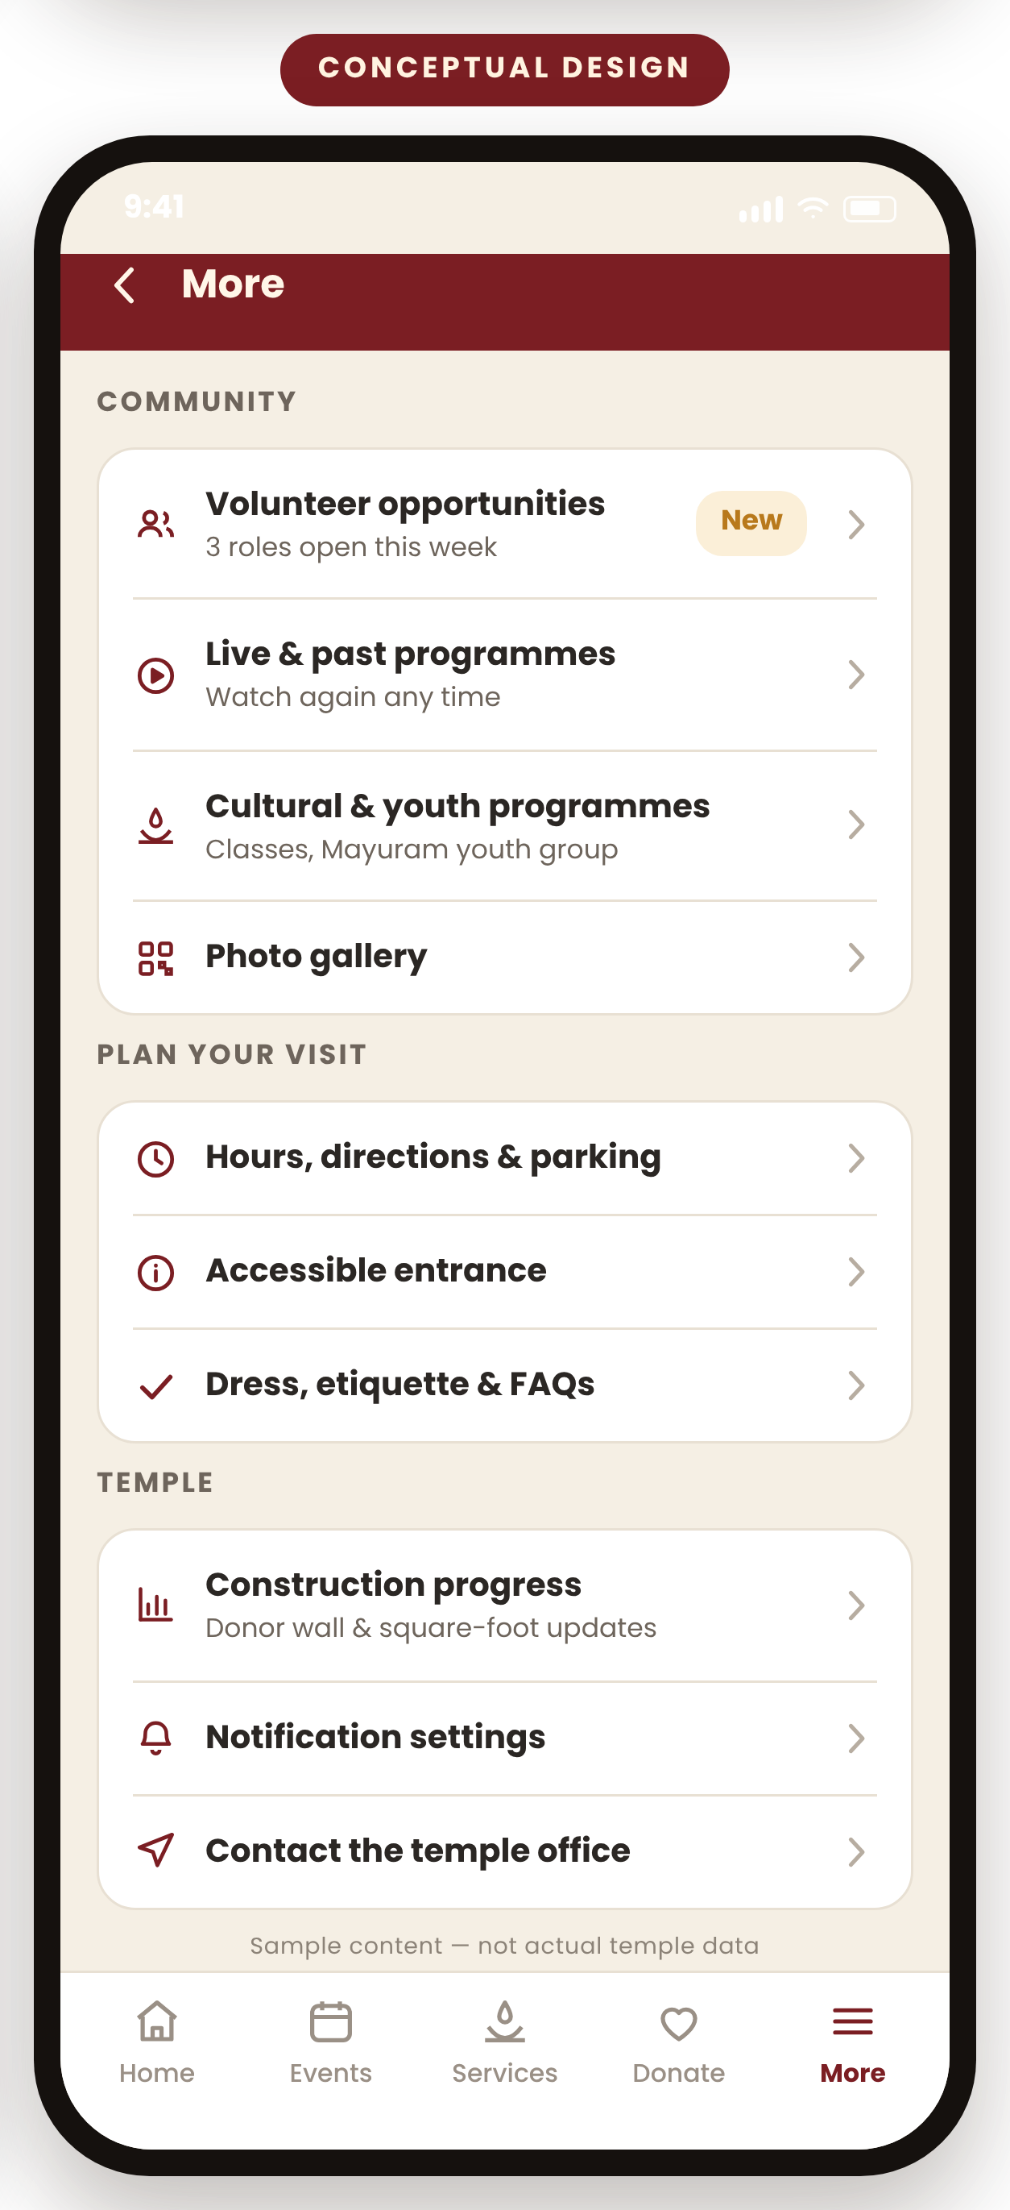



COMMUNITY
Everything that makes this a community, in one place
Volunteering
Live and past programmes
Cultural, youth and education
Roles attached to the event they support, with a reminder the day before. Today sign-up sits in a separate form.
Watch when a programme is on, and watch again afterwards, without hunting for the link.
Classes, cultural events and Mayuram youth activities alongside the religious calendar.
Gallery and devotional content
Announcements
Construction and donor progress
Photographs and devotional material the temple chooses to share, in a place families can browse.
One notice board, with the same message pushed to devotees who chose to receive it.
Square-foot and donor progression updates, shared as the building takes shape.
Confirmed from the temple website: Volunteer Sign Up (an embedded form), MTS Live with a past-programme playlist, Youth – Mayuram, Upcoming MTS Cultural Event, Donor List and the donor progression plan. Which photographs or devotional media may be used, and under what permission, Requires Temple Confirmation.
9
Notes:
Message: the app is not only a booking tool. It is where the community's life is visible.
Say: "Everything on this slide already exists somewhere. What it does not have is one front door."
Give volunteering the most time. Today a person signs up on a form that has no idea which event they are helping with. Attaching a role to an event, and reminding the volunteer the day before, is one of the plainest wins in the whole proposal.
On the gallery, say clearly that we will not put any photograph or devotional media in the app without the temple confirming we may use it.
Likely question: "Who keeps all this current?" — The admin screen on the next slide is the answer, and volunteer effort is one of the things the pilot measures.

Slide 10
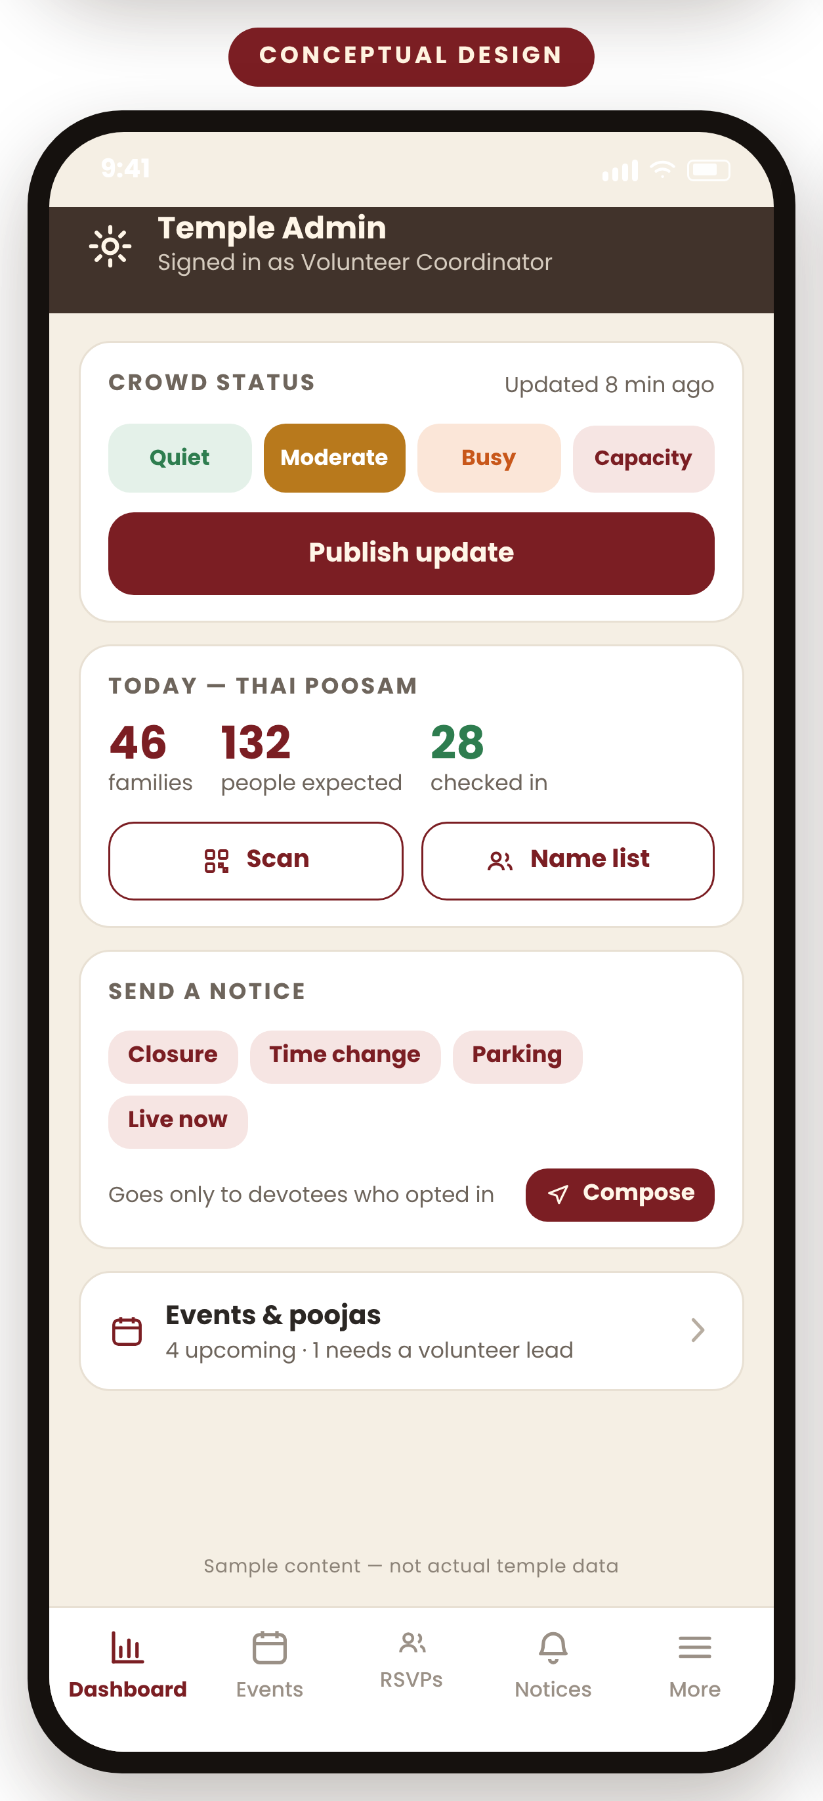


ACCESSIBILITY AND OPERATIONS
Simple for devotees. Lighter for the people who run it.
BUILT FOR EVERY DEVOTEE
Large type, strong contrast, big tap targets
And for the team
Sized for a reader who does not want to put their glasses on.
Update crowd status
Four buttons. Two taps. No webmaster.
A word and an icon, never colour alone
Crowd status, availability and confirmations are all readable without relying on colour.
See who is expected
Families, headcount and who has arrived.
Every action has a route that is not the app
Phone the office, or ask a volunteer at the desk. Nothing is app-only.
Send a notice
Volunteers can act on a family's behalf
Closure, time change, parking — from a template.
A volunteer can add an RSVP at the door, and find a family by name without a code.
Add or change an event
Only what is needed is collected
Without waiting for someone to edit the site.
No continuous location tracking, and no sharing of a devotee's details between families.
One place for RSVPs
Language options
Instead of a form, a spreadsheet and a phone.
Which languages the temple wants to offer — Requires Temple Confirmation.
Conceptual design. Counts, names and timings on the admin screen are illustrative sample data. Who may update crowd status or send a notice, and what approval a notice needs, Requires Temple Confirmation.
10
Notes:
Message: this only works if it is easy for a seventy-five-year-old devotee and easy for a volunteer on a Saturday.
Take the left column slowly. The most important line is the third one: every single thing the app does can also be done by telephoning the office or asking a volunteer. Nobody is shut out for not owning a smartphone.
Then turn to the admin screen. Note that it is a phone, not a computer — because the person updating crowd status is standing in the car park, not sitting at a desk.
Likely question from a trustee: "Does this create more work for volunteers?" — Be honest: at first, yes, a little. Whether it saves more than it costs is one of the things the pilot is designed to find out, and administrative time is on the measures list.
Assumption to validate: language needs, and who is authorised to send a notice on the temple's behalf.

Slide 11
A CONTROLLED START
Start small, prove value, then decide about the rest
In the first version
Deliberately left for later
Pilot on two real events
Home with hours and status
Events and family RSVP
Reminders and change alerts
Manual crowd status
QR and name check-in
Volunteer sign-up per event
Donate and sponsor entry points
Automatic crowd counting
Wallet passes and widgets
In-app payments if the temple prefers its existing route
Multi-language, until confirmed
Streaming built into the app
Anything requiring a new vendor
One recurring pooja
A service that happens every month, so we see whether the habit sticks and whether staff keep it current.
One major festival
A high-attendance day, so we see the app under crowd, parking and check-in pressure.
Both chosen with the priests and the events team.
1
Discovery
›
2
Prototype
›
3
Pilot build
›
4
Pilot and learn
Interviews and policy validation
A clickable design to react to
Only the first-version scope
Two real events, then a decision
Duration and cost are estimated after discovery, once requirements and integrations are known — not before.
What the pilot would measure: RSVP completion · attendance against RSVP · notification opt-in · reminder engagement · crowd-meter use · check-in success · volunteer participation · donation completion · reduction in repeat inquiries · administrative time saved · devotee satisfaction. No targets are being invented — the pilot establishes the baseline.
Scope, phases and measures are proposals for discussion. Which pooja and which festival to pilot, and what the temple considers success, Require Temple Confirmation.
11
Notes:
Message: we are proposing the smallest thing that could honestly prove or disprove the idea.
Say: "The middle column matters as much as the first. Knowing what we are not building is how a project like this stays affordable."
Explain the two pilot events in one line each: a recurring pooja tests whether the habit forms; a festival tests whether it survives a crowd.
Be very firm on money and dates. We are not giving a number today, because any number given before discovery would be invented. Cost drivers we already expect: how many integrations the temple needs, whether payments go through the existing store or a new route, how much content has to be migrated, and how much ongoing volunteer time is required.
On measures, say plainly: "We are not promising a percentage. The pilot sets the baseline, and then the board decides whether the numbers are worth continuing for."

Slide 12
THE DECISION
What we are asking the board to approve today
DECISIONS FOR THE BOARD
Approve a discovery phase and a controlled pilot
1
Who is the temple's decision owner for this work?
A short discovery phase
2
Which recurring pooja and which festival should the pilot use?
Interviews with priests, administrators, volunteers, donors, families and seniors
Validation of temple policies, workflows, service categories, capacity rules and payment constraints
3
Whom may we interview, and over what period?
A clickable mobile prototype for the board and devotees to react to
4
Which policies and service rules must be validated first?
A limited pilot using one recurring pooja and one major event or festival
5
What would make the board judge the pilot a success?
Not being asked for today: a production build, a budget commitment, a payment provider or vendor selection, or a launch date.
12
Notes:
Closing (about 90 seconds). Slow down here.
Say: "I am not asking you to approve an app. I am asking for permission to find out whether we should build one."
Read the five items on the left out loud, one at a time. They are the whole request.
Then turn to the right-hand column and ask for those five decisions in the room, or a named person to settle them within a fortnight. Getting a decision owner is the single most valuable outcome of this meeting.
Finish on the dark bar at the bottom, deliberately: no production build, no budget, no vendor, no launch date. That is what keeps this a safe decision.
Likely objection: "Why not just build a simple version and see?" — Because we would be guessing at the temple's own rules: capacity, who may cancel, what a private service request means, how payments must run. Discovery is cheaper than rebuilding.
Likely objection: "We have fundraising priorities." — Agreed, and this proposal does not compete with them. Discovery is small, and it can be stopped after the prototype with nothing lost but time.

Slide 13
APPENDIX A
Sources reviewed
Home and mission
Donations
murugantempleofstlouis.org · /our-mission
/donation · /donate-stocks · /donor-list · /donor-upgrade-plan
Services and pooja events
Square-foot giving
murugantempleofstlouis.org/store
/store/donate-one-square-feet · /store/square-feet-monthly-donation
Abhishekam sponsorship
Volunteer sign-up
/store?model_number=Annualabhishekam · /store?model_number=monthlyabishekam
murugantempleofstlouis.org/volunteer-sign-up
Priest information
Live streaming
murugantempleofstlouis.org/priest
murugantempleofstlouis.org/mts-live
Temple calendar
Youth programme
murugantempleofstlouis.org/calendar
murugantempleofstlouis.org/youth-mayuram
Digital calendar
Contact and location
murugantempleofstlouis.org/mts-digital-calendar
murugantempleofstlouis.org/contact
Cultural events
Reference patterns (TTD)
murugantempleofstlouis.org/upcoming-mts-cultural-event
tirumala.org · ttdevasthanams.ap.gov.in · TTD mobile app listing
All temple pages reviewed September 2026. TTD patterns were used only as reference for service discovery, booking confirmation, reporting instructions, donations, live content, visitor guidance and FAQs — its scale, branding and operating model are not proposed here.
Notes:
Reference slide. Do not present unless asked where a claim came from. Every green CONFIRMED label in the deck traces to one of these pages.

Slide 14
APPENDIX B
Assumptions requiring temple validation
Operations
Services and policy
Opening hours and seasonal variations (not published on the site)
Site capacity, parking capacity and overflow arrangements
Accessible entrance details
Who may update crowd status and send notices
Which services accept an RSVP, and which require a request
Capacity or booking limits per service or family
Cancellation, change and no-show rules
Whether a waitlist is wanted at all
Giving
People and data
Whether giving stays in the current store or moves
Payment constraints, fees and receipting requirements
Which sponsorship categories appear in a first version
What devotee data the temple is willing to hold
Consent, privacy notice and retention expectations
Language needs across the community
Existing tools already in use, including the Vetrivel / MTS POS link on the website
Nothing in this deck should be read as temple policy. Every item above is a question for discovery, not a decision that has been taken.
Notes:
Reference slide. Use it if a trustee asks 'what don't you know yet?' — the honest answer is this list, and it is the reason for asking for discovery rather than a build.

